Slide 1



/Dynamics365CommunityVietnam
Dynamics 365 & Power Platform Vietnam
Publish your App on AppSource
Phuoc Le
Microsoft Teams
24 Sep 2022 19:00 – 20:00 GMT+7
#D365PPVN
#ASEANSMSBizAppsUG

Slide 2



About me
Title: Dynamics 365 CRM Solutions Architect
Company: Hitachi Solutions Asia Pacific
Experience & skills: >14 years working on Dynamics 365
Connect with me
Phuoc Le
/in/levanphuoc
@phuocle
https://phuocle.net
#D365PPVN
#ASEANSMSBizAppsUG

Slide 3
Prepare for submitting with 4 steps
Create a Microsoft Partner Center account
Create a managed solution for your app
Create an AppSource package for your app
Store your package on Azure Storage
#D365PPVN
#ASEANSMSBizAppsUG

Slide 4
1. Create a Microsoft Partner Center account
Access url: https://partner.microsoft.com and register your partner account.
$100 once time only to register that you can list an offer to AppSource
A lot of steps from Microsoft to verify you like
Your mobilephone, email, current address, Id card (CMND), …
If your offer in AppSource that get $, you should provide the personal tax information at your country
Benefits after you became partner
Access DEMO page (https://cdx.transform.microsoft.com/)
Create FULL Dynamics 365 env with 1 click and 1 min to finish
25 users license, 90 days trial
A lot of use cases for DEMO to customer
MPN (Microsoft Partner Network) benefits
A lot of benefits in difference domain
For Dynamics 365, have an action pack then you can buy with 400$ per year
#D365PPVN
#ASEANSMSBizAppsUG

Slide 5
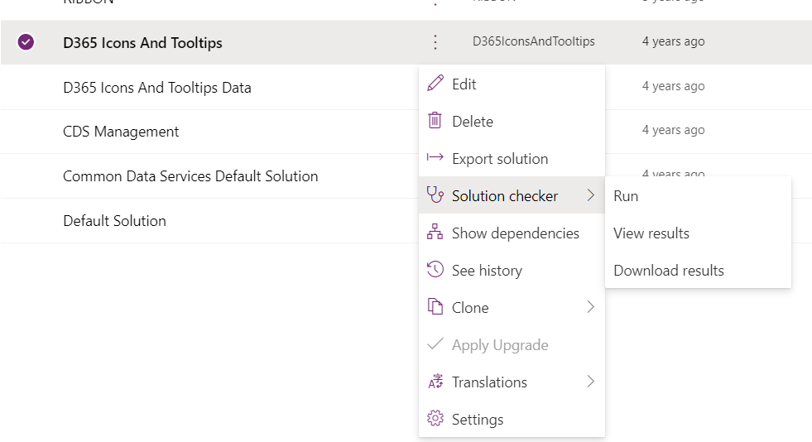
2. Create a managed solution for your app
Your solution should be managed
No dependencies with the others solution
Versioning solution as Microsoft recommended
Your un-managed solution should run Solution Checker and before you export managed solution.
You should fix all severity Critical, if you don’t do this on the step you prepare, at the step submit to AppSource, this solution will re-run with Solution Checker, and it will auto reject your offer with the severity Critical
#D365PPVN
#ASEANSMSBizAppsUG

Slide 6
3. Create an AppSource package for your app
Zip your managed solution file to another Zip file
Required by Microsoft when you want to publish your App to AppSource
Need follow step by step with this link https://learn.microsoft.com/en-us/power-apps/developer/data-platform/create-package-app-appsource
#D365PPVN
#ASEANSMSBizAppsUG

Slide 7
4. Store your package on Azure Storage
Upload your AppSource package you created at step 3. to Azure Storage
The final goal is the URL point to the AppSource package
This URL used to when you submit to AppSource
Make sure this URL live (SAS key, expire date, …)
#D365PPVN
#ASEANSMSBizAppsUG

Slide 8
Submit your app on Partner Center
Prepare media files
Prepare your test files
Submit your app
Result
#D365PPVN
#ASEANSMSBizAppsUG

Slide 9
1. Prepare media files
Your App when approved and listed to AppSource, need a lot of media files, (*) required
Your App Home Page (https://d365iconsandtooltips.com)
Icons, Preview pictures with correct size (height x width) (*)
Videos
Your Azure Storage Table to saved Lead (*) (when user install your App)
Noted: there are a lot of options
Introduce document (show in AppSource)(*), Help documents (User Guide)
Deep link to support page (https://d365iconsandtooltips.com/support.aspx) (*)
Deep link to privacy page (https://d365iconsandtooltips.com/privacy.aspx) (*)
Term of Use page (*)
#D365PPVN
#ASEANSMSBizAppsUG

Slide 10
2. Prepare your test files
Your App need test before list to AppSource
Provide your test plan when you submit
The more detail the more you can get pass the App
You need fix all feedback from Microsoft with your test plan like bug, tester don’t see your function, …
#D365PPVN
#ASEANSMSBizAppsUG

Slide 11
3. Submit your app
Used all files you prepare at step 1 and 2 to submit
A wizard page will help you submit one by one
Take time to submit all
#D365PPVN
#ASEANSMSBizAppsUG

Slide 12
4. Result
When you click the button SUBMIT App to AppSource, the processing submit your App begin
An automation tool will run first
Are your partner information valid ?
When some required information partner need, but you missed. (This happened when Microsoft update the partner portal site and need partner enter some required fields)
Are your App valid ?
Is your AppSource package valid
Are your App passed Solution Checker ?
On the prepare file, did you check your App with Solution Checker
Human validation (Microsoft Employee)
Used your Test Plan you submit to test your App
#D365PPVN
#ASEANSMSBizAppsUG

Slide 13
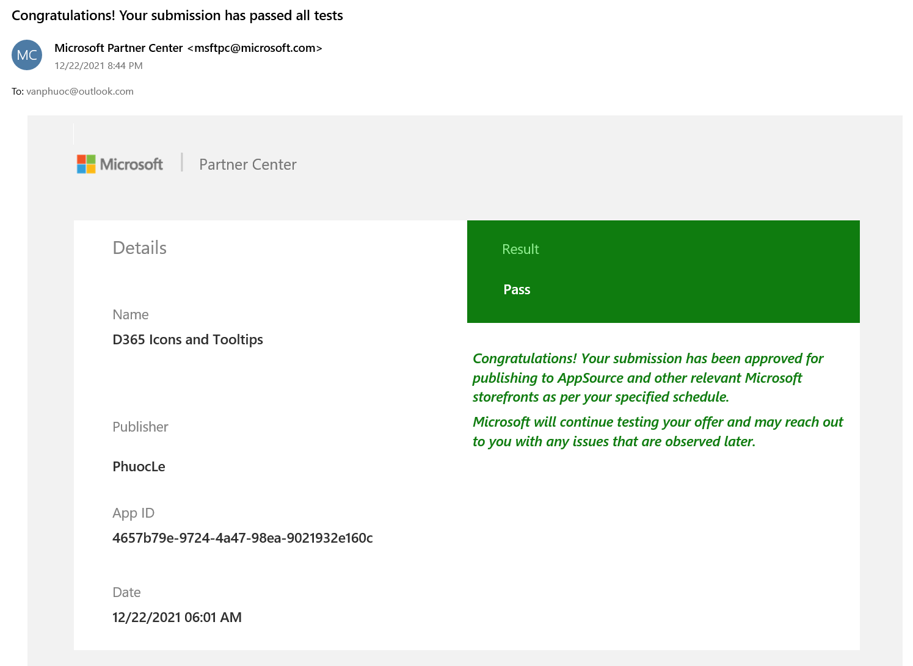
/Dynamics365CommunityVietnam
#D365PPVN
#ASEANSMSBizAppsUG

Slide 14
/Dynamics365CommunityVietnam
THANK YOU!
#D365PPVN
#ASEANSMSBizAppsUG

